Slide 1
Automating Asset Security in AWS
Automating security compliance with STIGS and CIS

Slide 2
The Problem Statement (add graphics)
Can we quickly automate STIG/CIS AMI’s for cloud assets?
Manually STIG’ing a server (in the cloud, but especially on premise) can take weeks (such as RHEL 7)
What if your system/application has hundreds of servers?

Slide 3
The Solution (fix)
Use existing AWS AMI
Apply security setting(s) with automated process
Create rapidly deployable, AMI for our use with our custom security settings

Slide 4
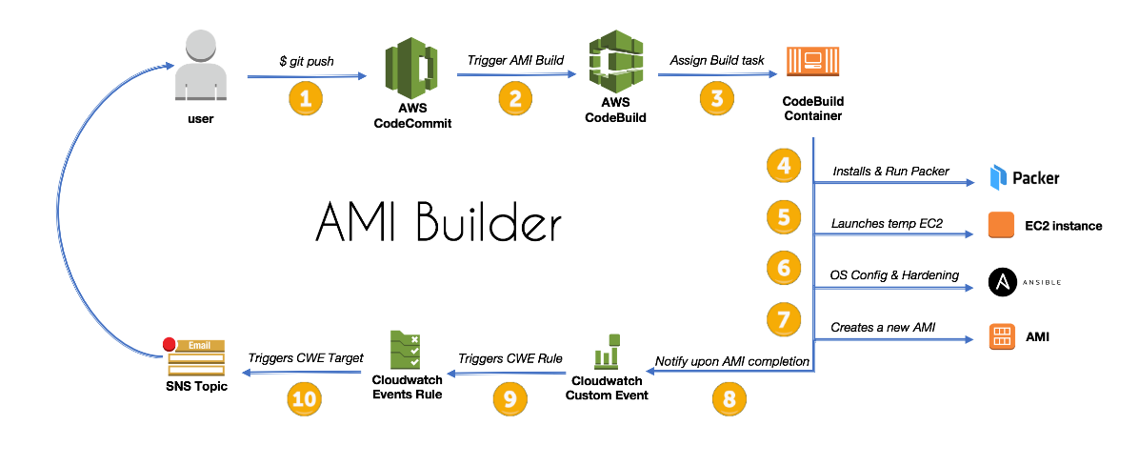
AMI Builder (CodeBuild and Packer)
REF: https://aws.amazon.com/blogs/devops/how-to-create-an-ami-builder-with-aws-codebuild-and-hashicorp-packer-part-2/

Slide 5

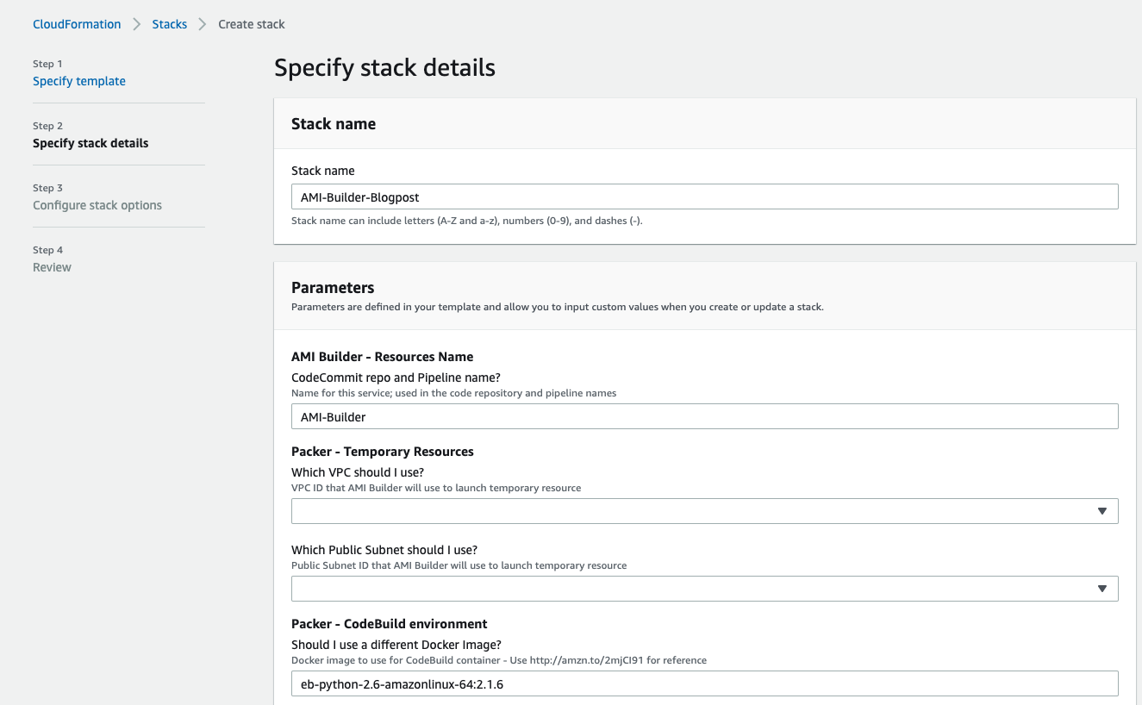
The PROCESS
We set up a CloudFormation template in order to leverage infrastructure as code (IaC) for automation and scaling in building out our environment
Parameters required include
Packer build elements
A VPC (none default) is required
A CodeBuild environment
And an SNS topic for notifications

Slide 6

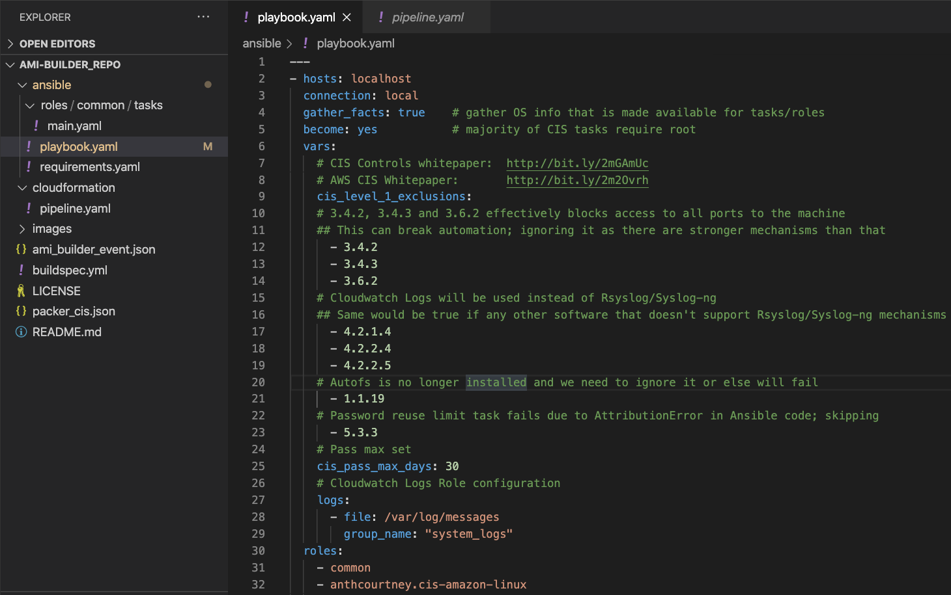
Image Blueprint
The customization for our image (AMI) comes from the use of Ansible Playbooks.
The CloudFormation template uses this playbook for our initial security settings
Our proof of concept was to take the CIS benchmarks playbook, and convert some settings into more secure settings in line with DISA STIGs
In our example we changed the maximum age of passwords to 30 days (STIGS typically require 60 days)

Slide 7
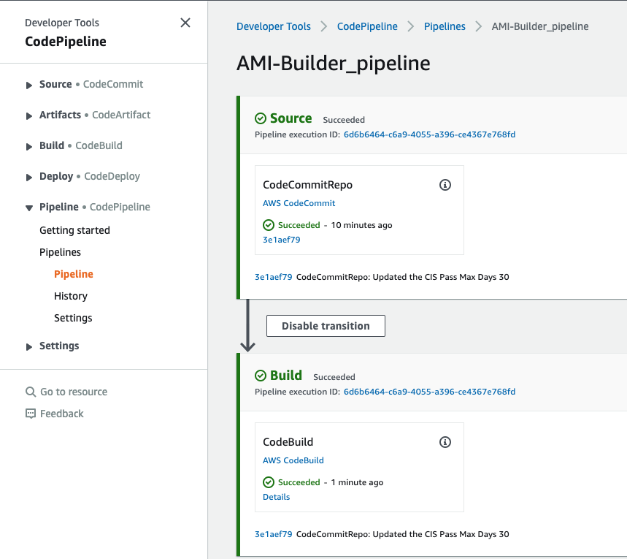
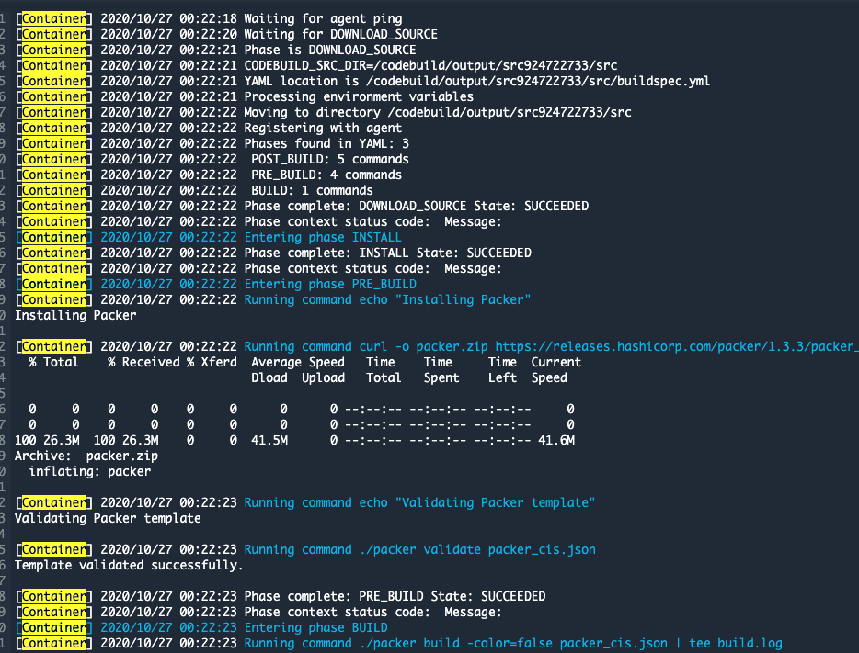




Packer Leveraging AWS to Build
The Ansible playbook with the updated security change code is committed
The code commit triggers the pipeline and initiates AWS CodeBuild
AWS CodeBuild leverages AWS EC2, Packer, and Ansible Playbooks in creating the AMI
Ansible and Packer are installed on the container which is leveraged to create the AMI

Slide 8
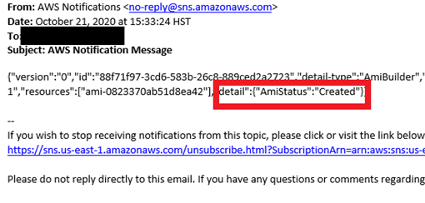
SNS Notification
Test
Test
Test

Slide 9
Finished Proof of Concept Product (fix)
Launched EC2 instance with AWS Linux2 AMI (to reduce costs during development)
Tested existing CIS hardening process which builds CIS hardened AMI
Modified hardening setting(s) to reflect DISA STIG requirement
Tested modified hardening process
Validated the modified hardening settings exist on new AMI build
Received email notification that the AMI build process had completed successfully

Slide 10
Back up slides

Slide 11
Where to start
AMI Builder using Ansible looked like a good place to start
Do not re-invent the wheel, improve or customize the product to meet our needs and desires
Learn from the struggles and progress of others
Be persistent, things do not always work the first time
TEAMWORK More eyes and brains on the process can find solutions faster

Slide 12
First Attempt

Slide 13
Lessons Learned

